Slide 1

教学辅助课件
牛津 七年级下

Slide 2

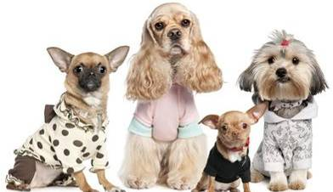
Unit 8 Pets
Study skills

Slide 3


Objectives
To be able to look for information
on the Internet
To be able to use search engines to get information

Slide 4
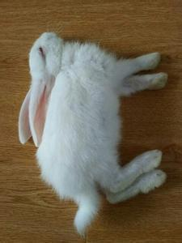

take her to the hospital?
My little rabbit is sick. What should I do?
ask my neighbours for help?
read books to find answers?
search for information on the Internet?
…

Slide 5

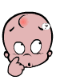
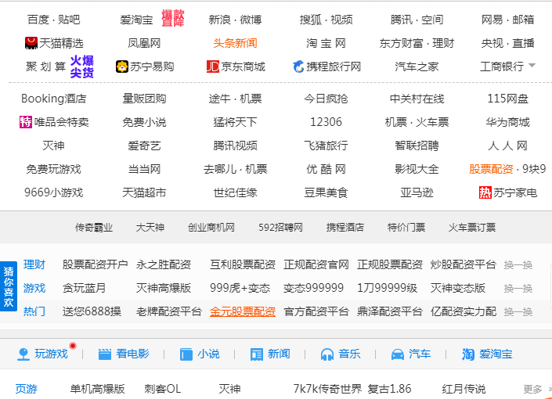



We can search for
information on the Internet.
The Internet is an international computer network. It connects computer networks all over the world.
People can get different kinds of information from it. There are millions of websites on the Internet.

Slide 6


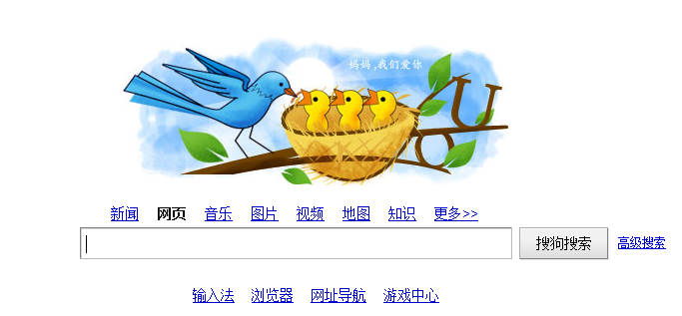
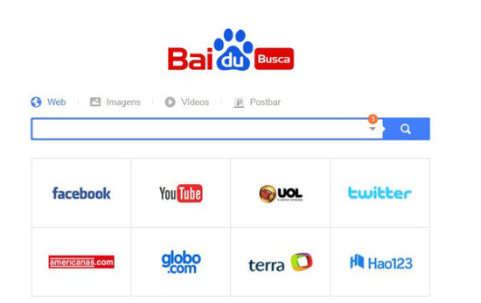

We can enter some key words into a search engine.
How?
Search engines help us find information quickly and easily. Type in a keyword or some keywords and the search engine will give you a list of relevant websites to look at.

Slide 7
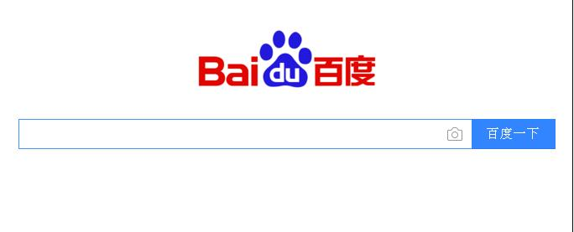
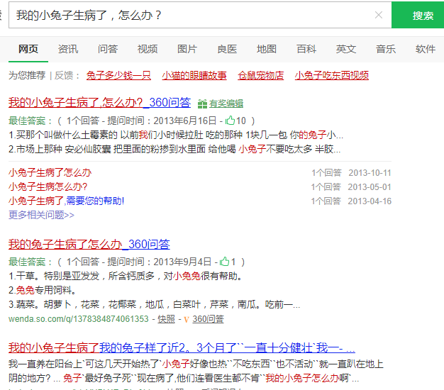
click on the icon
我的小兔子生病了，怎么办？
An example
enter the key words
Then you will get what you want.

Slide 8

1. Millie wants to
find information
about pets.
a. animals | Search
b. birds | Search
c. pets | Search
Millie and her friends are using search engines to find information. Help him choose the best keywords.
2. Simon wants to find information about how to look after a pet.
a. pet care | Search
b. pet | Search
c. pet problems | Search
a. different pets | Search
b. e-pet | Search
c. what to have as a pet | Search
3. Kitty wants to find information about keeping an e-pet.

Slide 9


Preview Task on P40.

